Slide 1


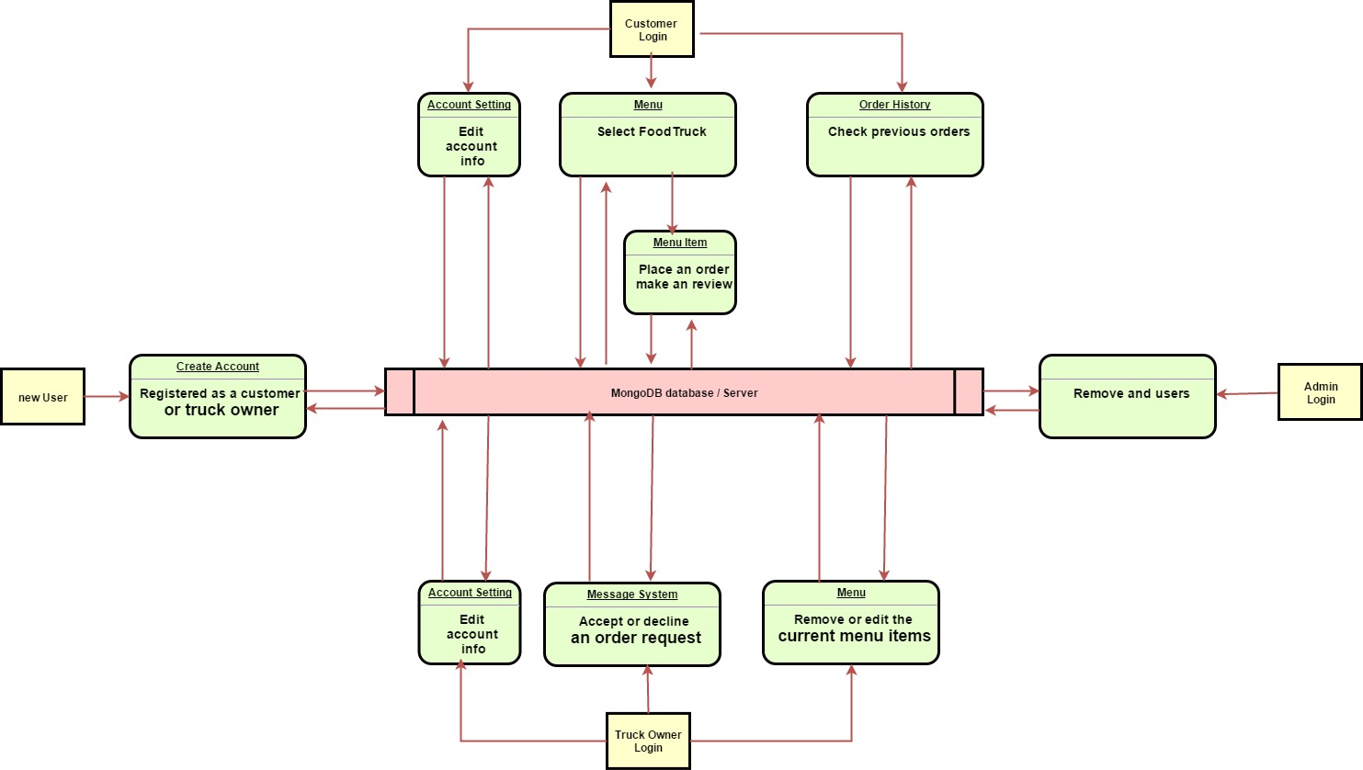
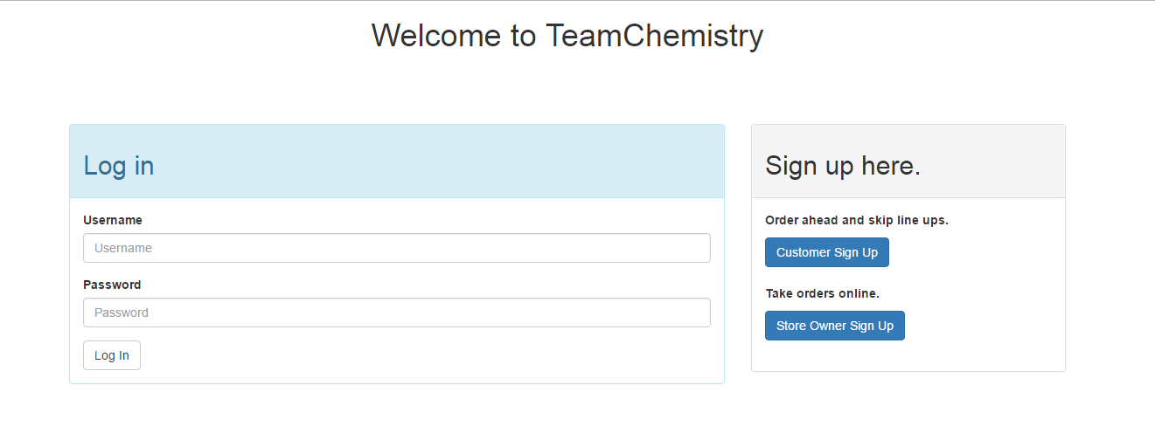
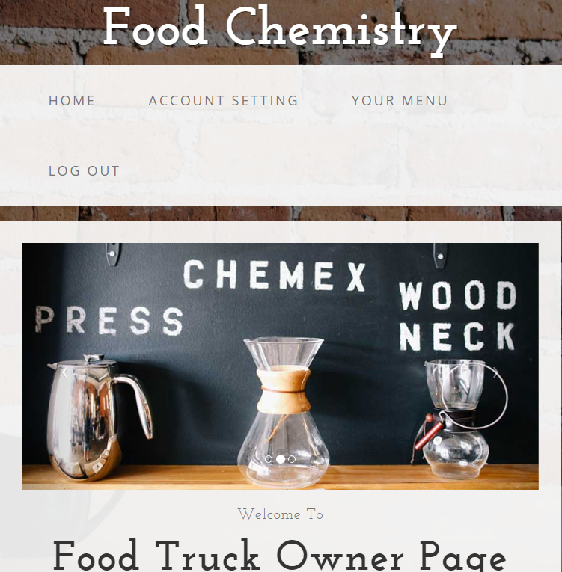
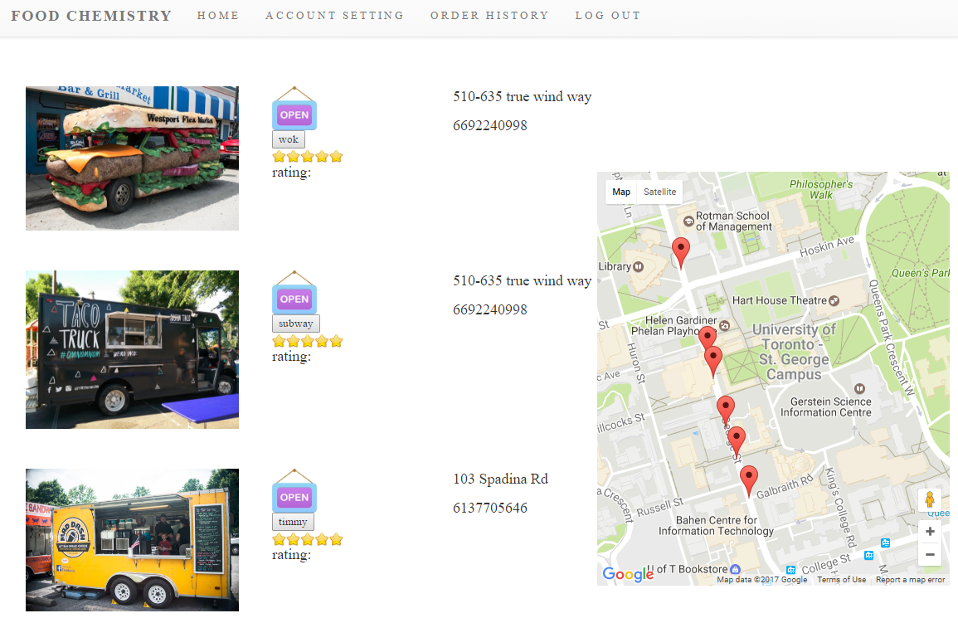
Team 01: FoodChemistry
A food service App
CSC309
Rebecca Eujin Choi – Undergraduate Student Email: team.member1@mail
Weonseok Kang– Undergraduate Student Email: team.member2@mail
Jiaxing Li– Graduate Student Email: jiaxing.li@mail.utoronto.ca
1
Description & Requirements
4
Design
It is a food service web app that allows users to be registered as a customer or a chef
Customers:
Order food from various chefs
Leave reviews and make a rating for chefs
Chefs:
Provide food selections and update food menus
Accept or decline an order
Administer:
View all the current registered users
Remove any inappropriate users
2
Features
Figure 2. Show the design of your project (via UML Diagram, MVC, ER diagram, loop event, etc.)
Mention the features of your project (such as responsive design, using semantic html, RESTful, etc.) by using bullets.
5
Statistics
Responsive design
Using Bootstrap framework
RESTful web services
Mention statistics of your project such as how many man-hours it took to design and implement, how many lines of code you ended up with, the number of classes, the technologies you used, and the number of methods in your project, etc.
8,000 lines of code overall(java script and ejs)
330 man-hours took for design and implement
Database using MangoDB, Server development using Node.js and using Express.js as frameworlk. Frontend design using jQuery API and Bootstrap framework
6
Future Work
3
Graphical User Interface
Talk about things that are missing from your project that should be implemented in the future, such as security, reliability and scalability aspects, etc.
Enhance User Interface
Deploy the app on a web platform such as heroku
Login Page
Truck Owner Page
Customer Page
7
References
Mention any references used to complete your project, including books, online tutorials, laboratories, youtube videos, etc.
http://www.xwcms.net/webAnnexImages/fileAnnex/20140316/73507/index.html
http://sc.chinaz.com/tag_jiaoben/gouwuche.html
Figure 1. Provide a few screens of your GUI here

